Slide 1

INL/MIS-22-68228
RAVEN Entities and Input Structure

Slide 2
Outline
Learn the concept of Entities in the RAVEN framework
Learn how these Entities are implemented in RAVEN
Learn the concept of Step
Learn how Steps and Entities are assembled in the RAVEN input file for the construction of a calculation flow
Basically, you should be able to start playing with RAVEN

Slide 3
RAVEN Entities
An Entity is a class of objects designed to perform a certain action
All the objects that belong to a certain Entity have a common definition of Input and Output needs
Calculation control
Physical and Mathematical Modeling
IO by files
Storage
RunInfo
Models
Files
Databases
DataObjects
Number of simultaneous model evaluations
Execution sequence
…
Codes
Surrogate models
Post-processors
…
Codes’ input files
Post-processor outputs
…
Codes’ outputs
RAVEN solutions
…
Stochastic Modeling
Perturbation
Export solutions
User input functions
Distributions
Samplers
OutStreams
Functions
Optimizers
1D distributions
ND distributions
Uncertainty propagation
Parameter optimization
…
CSV/XML output
Plotting
…
User defined functions
Goal functions
…

Slide 4
RAVEN Input Format
RAVEN input file
Highly modular input style
XML format (*.xml)
Stratified is a subnode of Samplers
name is an attribute of Stratified with the value test
1234 is the text (or value) of seed
Note: Order of appearance of each XML block is not important!
Node
Attribute
<Samplers>
<Stratified name='test'>
<samplerInit>
<seed>1234</seed>
</samplerInit>
</Stratified >
</Samplers>
Sub-node
Node Text

Slide 5
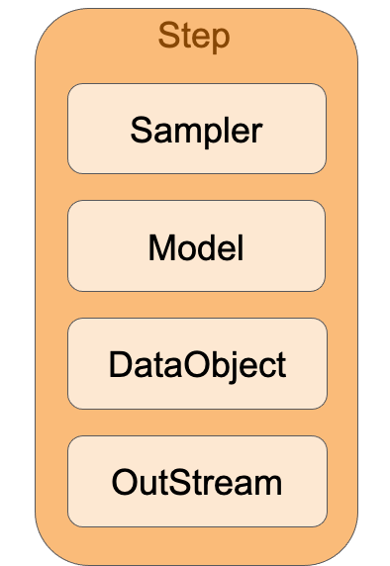
RAVEN Analysis
Type of information
What do I want to do? → RunInfo
What do I need to do it? → Entities
How do they work together? → Steps
Analysis example (one step)
Sample model
Store data
Print and plot data
Template of RAVEN input file
Distributions
Samplers
Optimizers
Models
Outstreams
DataObjects
Databases
RunInfo
Steps

Slide 6
Entity: Models
Models: Projection from input to output space
One sample at a time
Codes: Through code interfaces
External models: Python-based modules
Reduced order models (ROMs): surrogate models
Hybrid: Code & ROM
All samples at once: PostProcessors
Basic statistic operations
Clustering and data mining
Fourier transforms
…
Step
Sampler
Distributions
Model
DataObject
OutStream

Slide 7
Entity: Models
<Models>
<ExternalModel name=‘Name1’ subType=‘’ ModuleToLoad=‘./externalModel’>
<inputs>x, y</inputs>
<outputs>z</outputs>
</ExternalModel>
<Code name=‘Name2’ subType=‘Relap5’>
<executable>path/to/executable</executable>
</Code>
<ROM name=‘Name3’ subType=‘NDinvDistWeight’>
<Features>x, y</Features>
<Target>z</Target>
<p>3</p>
</ROM>
<PostProcessor name=‘Name4’ subType=‘BasicStatistics’>
<expectedValue prefix=‘mean’>x, y, z</expectedValue>
<variance prefix=‘var’>x, y, z</variance>
<sensitivity prefix=‘sens’>
<targets>z</targets>
<features>x, y</features>
</sensitivity>
</PostProcessor>
</Models>
Distributions
Samplers
Optimizers
Models
Outstreams
DataObjects
Databases
RunInfo
Steps

Slide 8
Entity: DataObject
Collecting and storing data
Three types
PointSet
HistorySet
DataSet
Used for all data transfer in RAVEN
Only live during run time!
Must use OutStream or Database to save on disk
Step
Sampler
Distributions
Model
DataObject
OutStream

Slide 9
Entity: DataObject
PointSet
Each input results in one value for each output
HistorySet
Each input results in a history of values output
Inputs
Outputs
Inputs
Pivot
Outputs
v0 | ang |  | range | ToF
30 | 45 |  | 91.8 | 4.33
20 | 15 |  | 20.4 | 1.06
40 | 60 |  | 141.4 | 7.07
v0 | ang |  | t | x(t) | y(t)
30 | 45 |  | 0 | 0.00 | 0.00
 |  |  | 0.48 | 10.2 | 9.07
 |  |  | 0.96 | 20.4 | 15.9
40 | 60 |  | 0 | 0.00 | 0.00
 |  |  | 0.79 | 15.7 | 24.2
 |  |  | 1.57 | 31.4 | 42.3
Sample 1
Sample 2
Sample 1
Sample 3
Sample 2

Slide 10
Entity: DataObject
Data Sets - Arbitrary Format
Inputs
Outputs
Indexes
v0 | ang | w(t) |  | range | x(t) | y(t) | a(v)
30 | 0.79 | -4 |  | 91.84 | 0.00 | 0.00 | 0.79
 |  | 2 |  |  | 10.2 | 9.07 | 0.66
 |  | -10 |  |  | 20.4 | 15.9 | 0.51
40 | 60 | 5 |  | 141.4 | 0.00 | 0.00 | 1.05
 |  | -1
 |  |  |  |  |  |  | 0.93
 |  |  |  |  | 15.7 | 24.2
 |  |  |  |  |  |  | 0.77
 |  | 3
 |  |  |  |  | 31.4 | 42.3
t | v
0 | 30.0
0.48 | 26.9
0.96 | 24.3
0 | 40.0
0.79
 | 33.6
1.57
 | 27.8
Sample 1
Sample 2

Slide 11
Entity: DataObject
<DataObjects>
<PointSet name=‘static_data’>
<Input>v0, ang</Input>
<Output>range, ToF</Output>
</PointSet >
<HistorySet name=‘time_dep_data’>
<Input>v0, ang</Input>
<Output>x, y</Output>
<options>
<pivotParameter>t</pivotParameter>
</options>
</HistorySet>
<DataSet name=‘data_set_data’>
<Input>v0, ang, w</Input>
<Output>range, x, y, a</Output>
<Index name=‘t’>x, y</Index>
<Index name=‘v’>a</Index>
</DataSet>
</DataObjects>
Distributions
Samplers
Optimizers
Models
Outstreams
DataObjects
Databases
RunInfo
Steps

Slide 12
Entity: Databases
Data storage entities
Store data in binary format
Formats: HDF5, netCDF4
DataObjects can be saved into Databases
Existing Databases can be loaded into the RAVEN framework

Slide 13
Entity: Databases
Distributions
<Databases>
<HDF5 name=‘database_A’ readMode=‘overwrite’/>
<HDF5
name=‘database_B’
directory=‘path_B’
readMode=‘overwrite’
/>
<NetCDF
name=‘database_C’
directory=‘path_C’
readMode=‘read’
filename=‘nameC.nc’
/>
</Databases>
Samplers
Optimizers
Models
Outstreams
DataObjects
Databases
RunInfo
Steps

Slide 14
Entity: Distributions
Stochastic representation of variable
1D distributions (continuous and discrete)
Normal
Beta
Binomial
…
ND multi-dimensional distributions
Multivariate normal
Custom n-Dimensional
Step
Sampler
Distributions
Model
Data Object
OutStream

Slide 15
Entity: Distributions
<Distributions>
<Normal name='x_distrib'>
<mean>2</mean>
<sigma>0.2</sigma>
</Normal>
<MultivariateNormal name=’y_z_distrib'>
<mu>0.0 2.0</mu>
<covariance>
1.0 0.8
0.8 1.0
</covariance>
</MultivariateNormal>
</Distributions>
Distributions
Samplers
Optimizers
Models
Outstreams
DataObjects
Databases
RunInfo
Steps

Slide 16
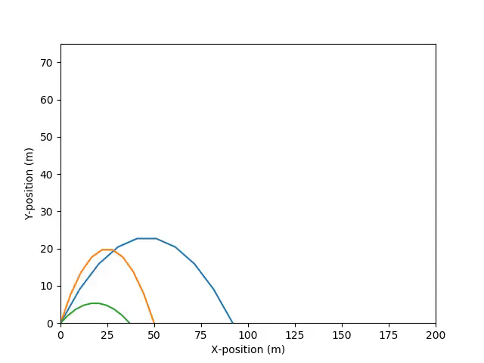
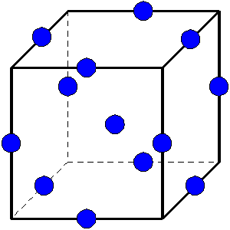
Entity: Samplers
Step
Sampler
Distributions
Input space sampling entities
Forward Samplers
Monte-Carlo
Stratified (LHS)
Grid, etc.
Adaptive samplers (smart sampling)
Dynamic event tree Samplers
Model
Data Object
OutStream

Slide 17
Entity: Samplers
<Samplers>
<MonteCarlo name='MCsampler'>
<samplerInit>
<limit>5000</limit>
</samplerInit>
<variable name=‘x1’>
<distribution>x1_distrib</distribution>
</variable>
<variable name=‘x2’>
<distribution>x2_distrib</distribution>
</variable>
</MonteCarlo>
<Grid name=’GridSampler’>
<variable name=‘x1’>
<distribution>x1_distrib</distribution>
<grid type=‘CDF’ construction=‘equal’ steps=’10’>0.0 1.0</grid>
</variable>
<variable name=‘x2’>
<distribution>x2_distrib</distribution>
<grid type=‘value’ construction=‘equal’ steps=‘8’>0.1 0.9</grid>
</variable>
</Grid>
</Samplers>
Distributions
Samplers
Optimizers
Models
Outstreams
DataObjects
Databases
RunInfo
Steps

Slide 18
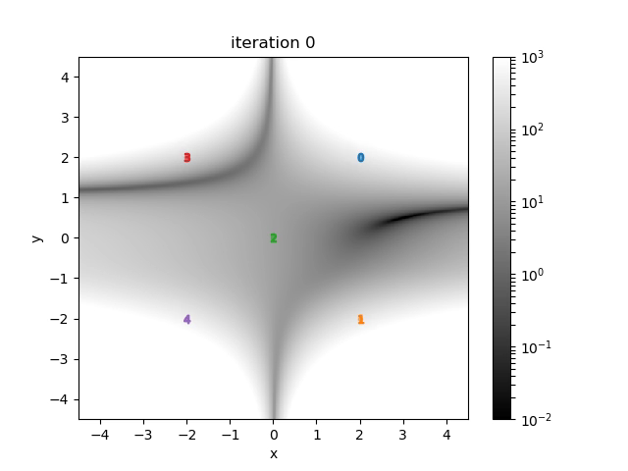
Entity: Optimizers
Optimizers: Input space parameter optimization
Finite difference gradient descent
Simulated annealing
Genetic algorithms

Slide 19
Entity: Optimizers
<Optimizers>
<GradientDescent name="opter">
<objective>ans</objective>
<variable name="x">
<distribution>beale_dist</distribution>
<initial>-2</initial>
</variable>
<TargetEvaluation class="DataObjects"
type="PointSet">optOut</TargetEvaluation>
<samplerInit>
<limit>100</limit>
</samplerInit>
<gradient><FiniteDifference/></gradient>
<stepSize>
<GradientHistory>
<growthFactor>1.25</growthFactor>
<shrinkFactor>1.5</shrinkFactor>
</GradientHistory>
</stepSize>
<acceptance><Strict/></acceptance>
</GradientDescent>
</Optimizers>
Distributions
Samplers
Optimizers
Models
Outstreams
DataObjects
Databases
RunInfo
Steps

Slide 20
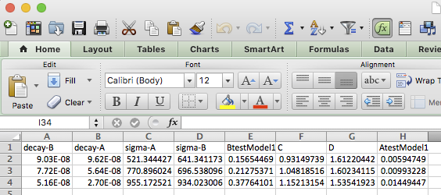
Entity: OutStreams
Step
Sampler
Distributions
OutStreams: Used for data exporting/dumping
Printing:
DataObjects
ROMs
Plotting: Both 2D and 3D plotting available
4D by using color mapping
5D by using marker size
Model
Data Object
OutStream

Slide 21
Entity: OutStreams
<OutStreams>
<Print name=’exportCSV’>
<type>csv</type>
<source>DataObject</source>
</Print>
<Plot name=’makeAPlot’>
<plotSettings>
<plot>
<type>scatter</type>
<x>DataObject|Output|time</x>
<y>DataObject|Output|anOutput</y>
</plot>
<xlabel>time<xlabel>
<ylabel>anOutput<ylabel>
</plotSettings>
<actions> <how>png,screen</how>
<title> <text> This is a plot </text> </title>
</actions>
</Plot>
</OutStreams>
Distributions
Samplers
Optimizers
Models
Outstreams
DataObjects
Databases
RunInfo
Steps

Slide 22
RAVEN Steps
Connecting the RAVEN Entities
Step
Sampler
Distributions
Model
Data Object
OutStream

Slide 23
RAVEN Steps
A Step links Entities together to perform an action
Multiple heterogeneous Entities are used in a single Step (DataObjects, Samplers, Models, …)
All these Entities must be defined in their corresponding block
They can be defined after the Steps block
RunInfo
Entity 1
Entity 2
…
Entity n
Steps
<Steps>
<StepType1 name=’simple_MultiRun'>
…
</StepType1>
<StepType2 name=’simple_PostProcess'>
…
</StepType2>
</Steps>

Slide 24
RAVEN Step: Types
SingleRun: Run a model once
MultiRun: Run a model many times
RomTrainer: Train a ROM
PostProcess: Act on all samples in a DataObject at once
IOStep:
DataObject to Database (or vice versa)
Store or load data, HDF5
File to DataObject
Load data from CSV
DataObject to OutStream
Print CSV or plot
Model to File (or vice versa)
Serialize (“pickle”) ROM to file
Model to OutStream
Print ROM metadata information
Distributions
Samplers
Optimizers
Models
Outstreams
DataObjects
Databases
RunInfo
Steps

Slide 25
RAVEN Steps
Each Entity has a role
Input
Output
Model
Sampler
Etc.
<Steps>
<MultiRun name=’StepName’>
<Input class=’Files’ type=’’>anInputFile.i</Input>
<Input class=’Files’ type=’’>anAuxiliaryFile</Input>
<Model class=’Models’ type=’Code’>aCode</Model>
<Sampler class=‘Samplers’ type=’MonteCarlo’>aSampler</Sampler>
<Output class=’Databases’ type=’HDF5’>aDatabase</Output>
<Output class=’DataObjects’ type=’History’>aData</Output>
</MultiRun>
</Steps>

Slide 26
RAVEN RunInfo
Desired analysis
Sequence of Steps
Working directory
Parallel computation parameters
…
RunInfo
Entity 1
Entity 2
…
Entity n
Steps
# of simultaneous code evaluations
<RunInfo>
<batchSize>6</batchSize>
<WorkingDir>./myDir</WorkingDir>
<Sequence>Step2,Step3,Step6</Sequence>
</RunInfo>

Slide 27
Summary
RunInfo
Overview
What do I want to do?
How do I parallelize?
Entities
RAVEN objects
What entities do I need?
What do they need to know?
Steps
Putting everything together
How will entities do what I want?
Distributions
Samplers
Optimizers
Models
Outstreams
DataObjects
Databases
RunInfo
Steps

